Slide 1
EDUC 15: Statistics for education research
Lecture 13
School of Education
UCI
Notes:
http://www.pewresearch.org/fact-tank/2016/11/09/why-2016-election-polls-missed-their-mark/

Slide 2
Bivariate regression
Suppose we are interested in the correlation between hours of studying and test scores, r=.81
What are their correlation?
Positive
Strong
Fairly linear
Can we predict the students’
grades based on their
studying hours?

Slide 3
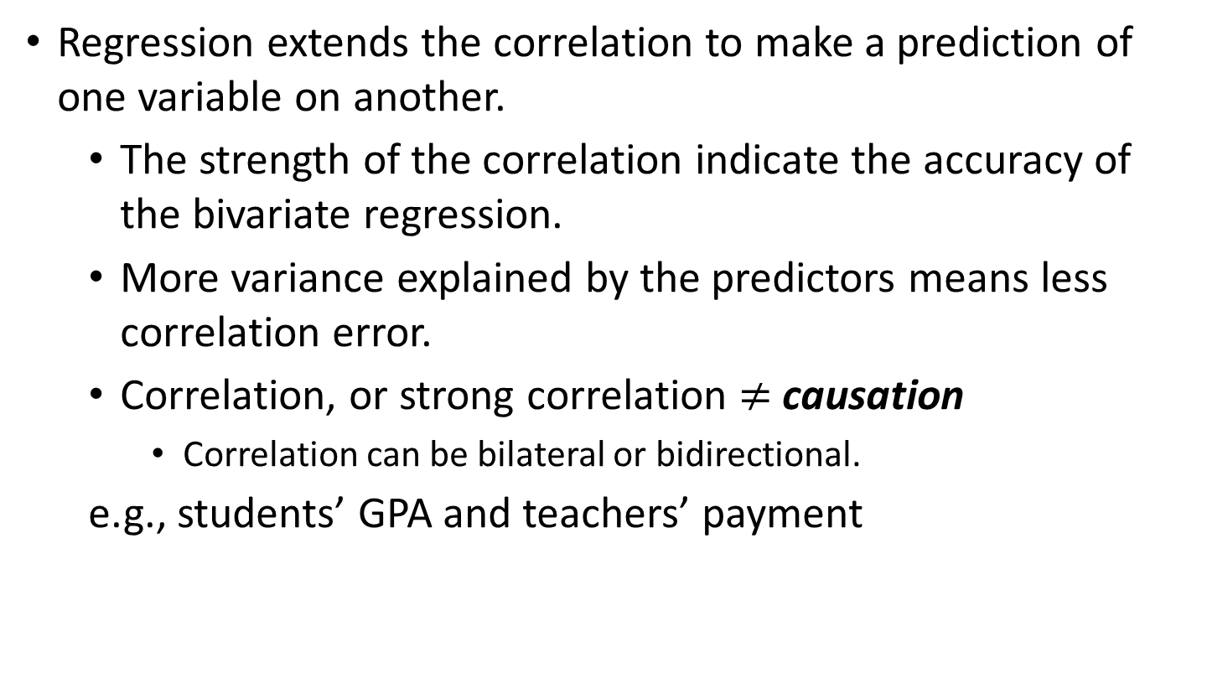
Correlation and Regression
Regression extends the correlation to make a prediction of one variable on another.
The strength of the correlation indicate the accuracy of the bivariate regression.
More variance explained by the predictors means less correlation error.
Correlation, or strong correlation $≠$ causation
Correlation can be bilateral or bidirectional.
e.g., students’ GPA and teachers’ payment

Slide 4
Regression Analysis Variables
The predictor variables
independent variable denoted by x
The criterion variable which is regressed on the predictor variable.
The dependent variable denoted y’
H0: the students’ study hours could not predict their grade.
Ha: the students’ study hours predict their grades.

Slide 5
The Correlation Coefficient
The proportion of dependent variable explained by the other independent variables.
This value is the significant Pearson correlation value squared: r²_{xy}
For r=0.81; r² = .656
65.6% of variation of students’ grade can be explained by their study hours.

Slide 6
The Regression Equation with One Predictor
A bivariate or simple regression is used when one predictor variable is used to predict the criterion variable.
y’ = a + bx
Where y’ = the predicted value of the criterion variable
a = the intercept
b = the slope of the regression line
x = the value of the predictor variable
y’ = the value predicted by X

Slide 7
Calculating the Intercept (a)
a = M_{y} – bM_{x}
Where a = the intercept is the value of y when x = 0.
b = the slope of the regression line
M_{y} = the mean of the criterion variable
M_{x} = the mean of the predictor variable
For example, if the number of absences is used to predict a student’s test grade (the criterion), a indicates what the student’s score will be if the student misses 0 days.

Slide 8
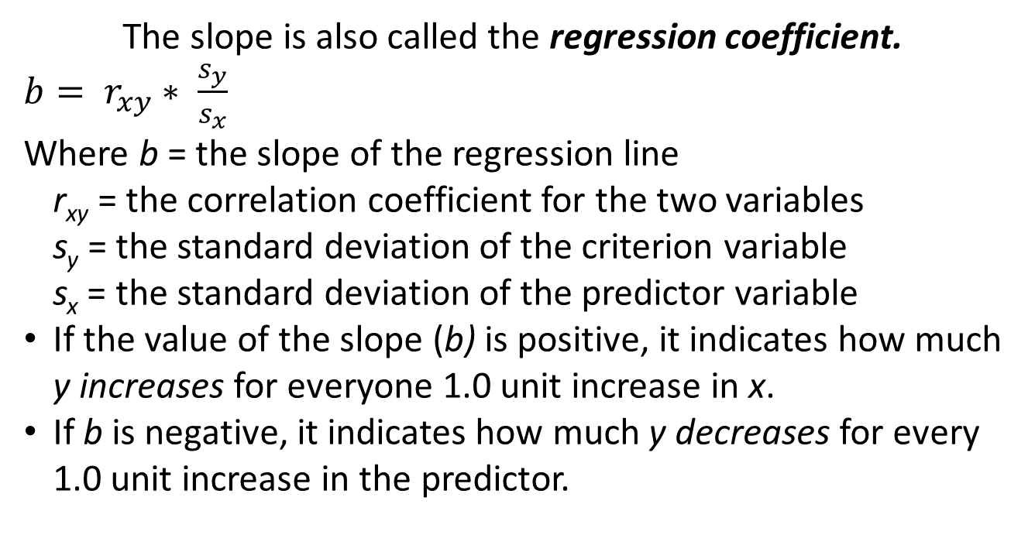
Calculating the Slope (b)
The slope is also called the regression coefficient.
$b= r_{xy}∗ \frac{s_{y}}{s_{x}}$
Where b = the slope of the regression line
r_{xy} = the correlation coefficient for the two variables
s_{y} = the standard deviation of the criterion variable
s_{x} = the standard deviation of the predictor variable
If the value of the slope (b) is positive, it indicates how much y increases for everyone 1.0 unit increase in x.
If b is negative, it indicates how much y decreases for every 1.0 unit increase in the predictor.

Slide 9
In-Class Practice
$$\hat{Wgt}=−260.4+6.02∗Hgt$$
Weight (wgt) is measured in pounds and height (hgt) in inches
What is the correct interpretation for the slope?
The average subject is just over 6 feet tall.
For every extra 6.02 inches in height, the predicted weight goes up by one pound.
Predicted weight increases by 6.02 pounds for every additional inch in height.
None of the above

Slide 10

In-Class Practice
$$\hat{Wgt}=−260.4+6.02∗Hgt$$
Weight (wgt) is measured in pounds and height (hgt) in inches
What is the correct interpretation for the y-intercept?
The average subject is just over 6 feet tall.
The predicted weight for someone that is 0 inches tall is 260.4 lbs.
For every 6.02 inches in height, weight goes up by 1 lb.
A zero inch tall person is predicted to weigh about $−260.4$ lbs.

Slide 11
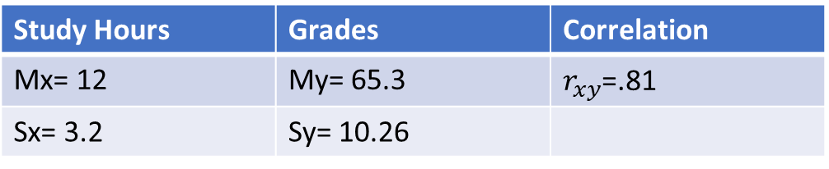
Example- Study Hours and Grades
The UCI Psychology Professor wants to study the regression between the study hours and grades. If he collects data on a sample of college students and get the results below.
What is the null and alternative hypothesis for his study?
What is the regression equation between the UC Irvine college students’ study hours and grades?
Could the professor conclude what is the students’ grade if they study 13 hours?
Study Hours | Grades | Correlation
Mx= 12 | My= 65.3 | $r_{xy}$=.81
Sx= 3.2 | Sy= 10.26

Slide 12

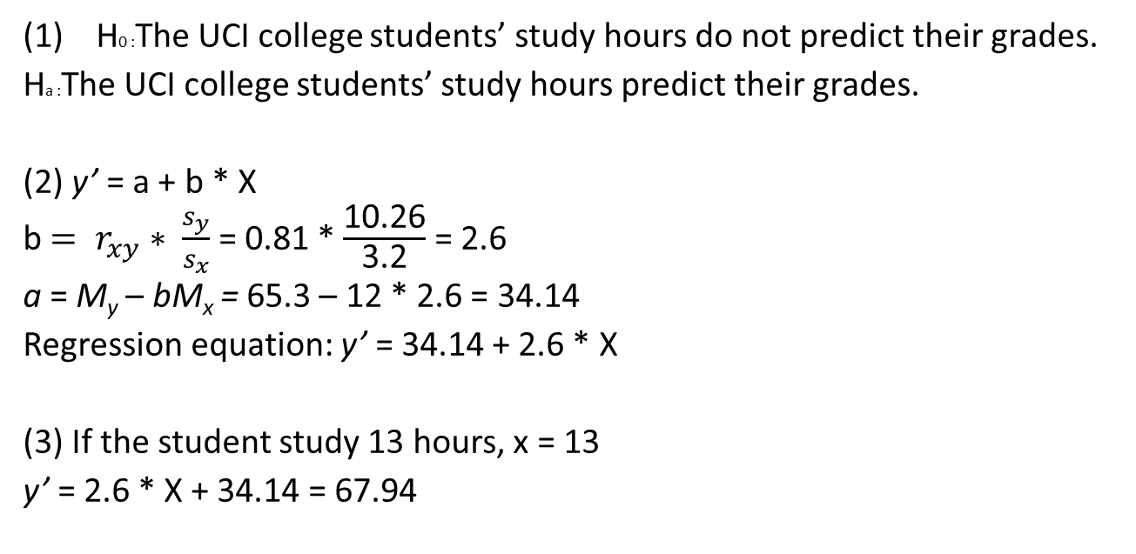
Example- Study Hours and Grades
Study Hours | Grades | Correlation
Mx= 12 | My= 65.3 | $r_{xy}$=.81
Sx= 3.2 | Sy= 10.26
H0 :The UCI college students’ study hours do not predict their grades.
Ha :The UCI college students’ study hours predict their grades.
(2) y’ = a + b * X
b $= r_{xy}∗ \frac{s_{y}}{s_{x}}$ = 0.81 * $\frac{\text{10.26}}{\text{3.2}}$ = 2.6
a = M_{y} – bM_{x} = 65.3 – 12 * 2.6 = 34.14
Regression equation: y’ = 34.14 + 2.6 * X
(3) If the student study 13 hours, x = 13
y’ = 2.6 * X + 34.14 = 67.94

Slide 13
Predictions and Effects
Regressions really do two things:
Identify effects
Help us make predictions
For the example of hours of study and test score:
Regression line: y’=a+bx
Test score=34.1 + 2.6*hours
There is a 2.6 point test score effect of studying an additional hour
We can also plug values for hours into the equation and make test score predictions

Slide 14
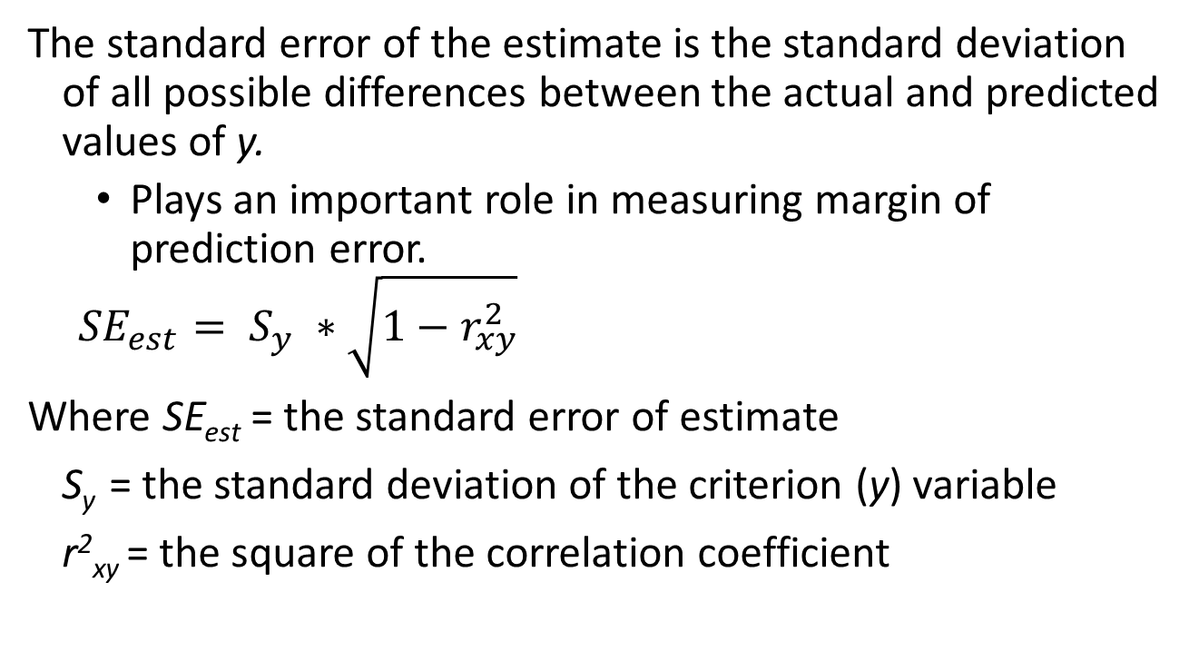
Prediction Errors
The standard error of the estimate is the standard deviation of all possible differences between the actual and predicted values of y.
Plays an important role in measuring margin of prediction error.
$${SE}_{est}= S_{y} ∗\sqrt{1−r_{xy}^{2}}$$
Where SE_{est} = the standard error of estimate
S_{y} = the standard deviation of the criterion (y) variable
r²_{xy} = the square of the correlation coefficient

Slide 15
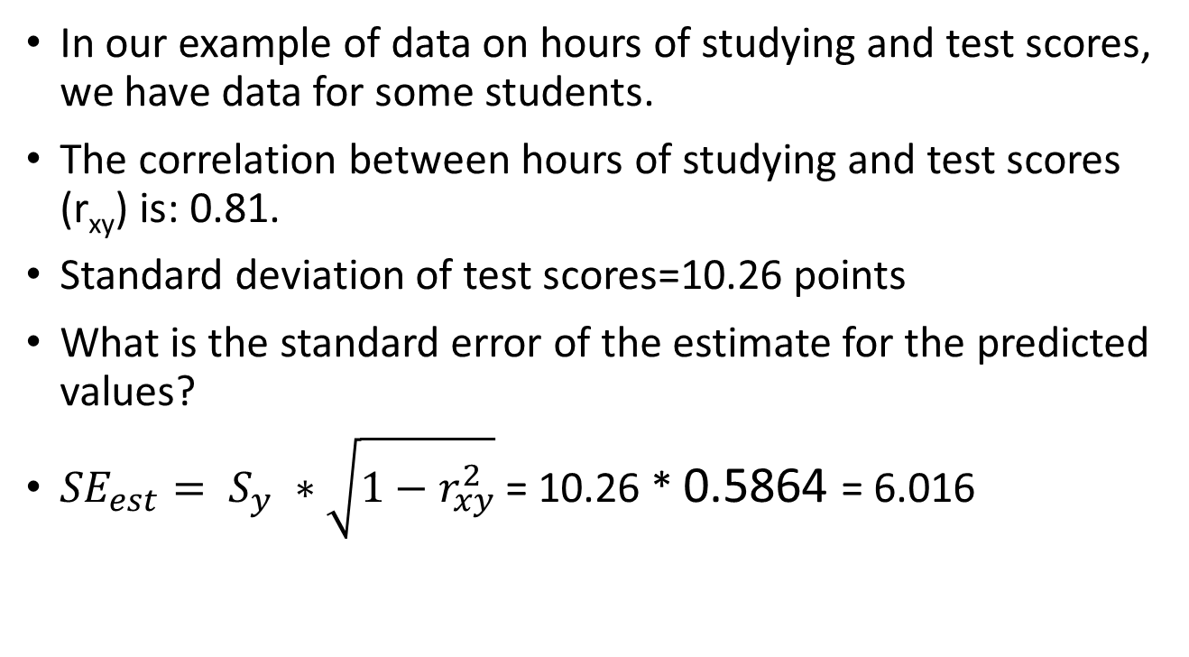
Standard error of the estimate: example
In our example of data on hours of studying and test scores, we have data for some students.
The correlation between hours of studying and test scores (r_{xy}) is: 0.81.
Standard deviation of test scores=10.26 points
What is the standard error of the estimate for the predicted values?
${SE}_{est}= S_{y} ∗\sqrt{1−r_{xy}^{2}}$ = 10.26 * 0.5864 = 6.016

Slide 16
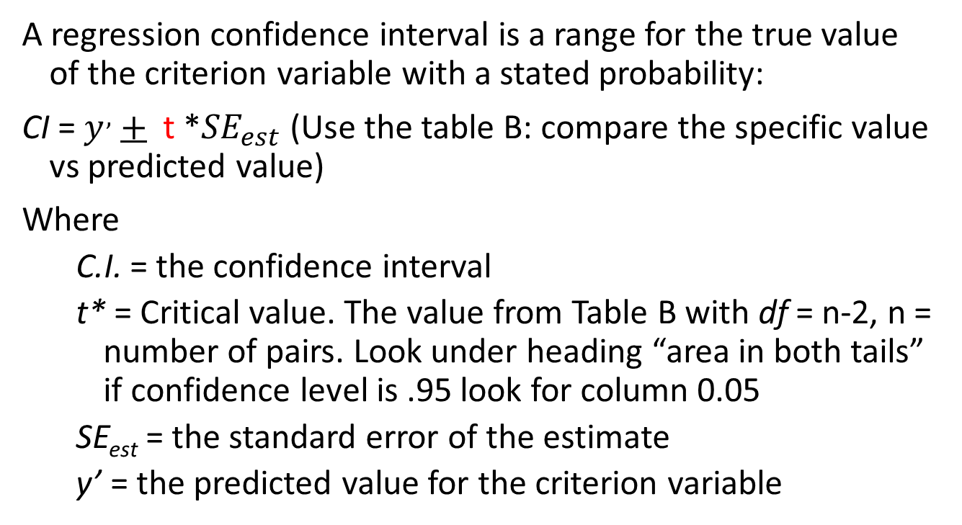
A Confidence Interval for the Estimate of y (y’)
A regression confidence interval is a range for the true value of the criterion variable with a stated probability:
CI = $y^{,}$+ t *${SE}_{est}$ (Use the table B: compare the specific value vs predicted value)
Where
C.I. = the confidence interval
t* = Critical value. The value from Table B with df = n-2, n = number of pairs. Look under heading “area in both tails” if confidence level is .95 look for column 0.05
SE_{est} = the standard error of the estimate
y’ = the predicted value for the criterion variable

Slide 17
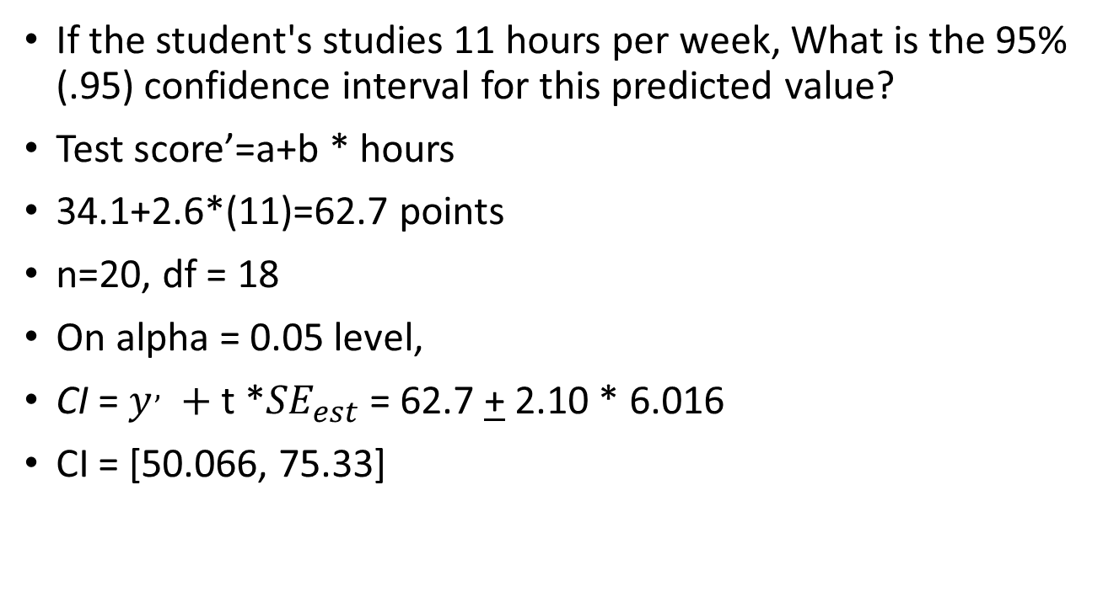
Confidence interval of the estimate: an example
If the student's studies 11 hours per week, What is the 95% (.95) confidence interval for this predicted value?
Test score’=a+b * hours
34.1+2.6*(11)=62.7 points
n=20, df = 18
On alpha = 0.05 level,
CI = $y^{,} +$t *${SE}_{est}$ = 62.7 + 2.10 * 6.016
CI = [50.066, 75.33]

Slide 18
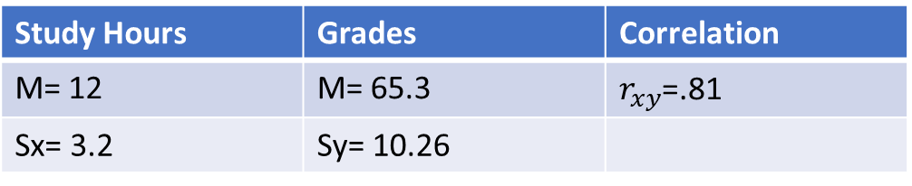
Calculate the error
Study Hours | Grades | Correlation
M= 12 | M= 65.3 | $r_{xy}$=.81
Sx= 3.2 | Sy= 10.26
The students had been 16 hours and scored 88 (y = 88). By how much would we have over/under predicted his/her work (i.e., how much error)?
Y’ = 2.6 * X + 34.135 = 75.735
Error = 88- 75.735 = 12.265
We underestimate 12.27 scores of the students’ work.

Slide 19
Minimizing the error (sum of squared differences)
y’: predicted
e_{i = Residual}
y_{i}: observed
Vertical distance =

Slide 20
Chi-square test
Chi-squared test investigate the association of two variables measured at an ordinal or nominal level : χ² test.
Whether there is linear correlation between two categorical variables. (e.g., dummy coded: 0 and 1).
Investigate the distribution of the IV groups on the DV groups/levels, such as using Cross-Tabulation.
illustrate the SPSS Statistics procedure to perform a chi-square test

Slide 21
Chi-Square Chocolate Flavor Activities
The EDU Instructor want to know her students’ gender distributions associated with the preferred type of chocolates.
She has such Chi-square hypothesis:
Ho: the proportions of male and female groups’ chocolate preference are the same.
Ha. the proportions of male and female groups’ chocolate preference are the different.
Activities Instruction:
Each student pick up a piece of the chocolate; you can only pick either flavor of milk or almond, why?
What is the statistical results, significantly or not, and why?

Slide 22
Data Analysis
Inputting data
Upload the data to SPSS
Create the coding
Run analysis
Interpret the findings
There is an association between the gender distribution and chocolate flavor preferences.
We found the pattern that the girls are more likely to choose milk, and dislike almond.

Slide 23
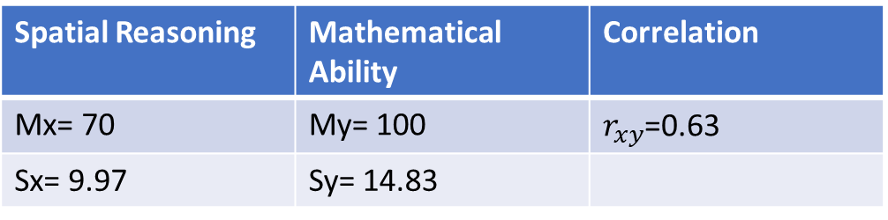
In-Class Practice
Spatial Reasoning | Mathematical Ability | Correlation
Mx= 70 | My= 100 | $r_{xy}$=0.63
Sx= 9.97 | Sy= 14.83
Paolo wants to study relation between spatial reasoning and mathematical ability. He thinks spatial reasoning leads to more math ability, n = 20.
What is H0 and Ha?
What is the critical value r (check out Table E), when n (pair) = 20, did your finding reject the H0, and why?
What is the regression equation of spatial reasoning and mathematical ability?
How much variance of the mathematical ability can be explained by spatial reasoning?
Rachel got 80 in her spatial reasoning class, what is her predicted mathematical ability? If she actually got 120 score for her mathematical ability, what is the error/residual of her mathematical ability?

Slide 24
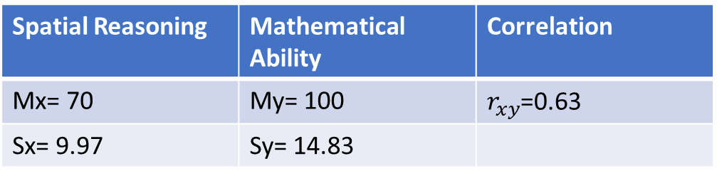
In-Class Practice
Spatial Reasoning | Mathematical Ability | Correlation
Mx= 70 | My= 100 | $r_{xy}$=0.63
Sx= 9.97 | Sy= 14.83
Paolo wants to study the correlation between spatial reasoning and mathematical ability. He thinks spatial reasoning leads to more math ability, n = 20.
(1)
H0: spatial reasoning can not predict mathematical ability.
Ha: the spatial reasoning predicts mathematical ability.

Slide 25
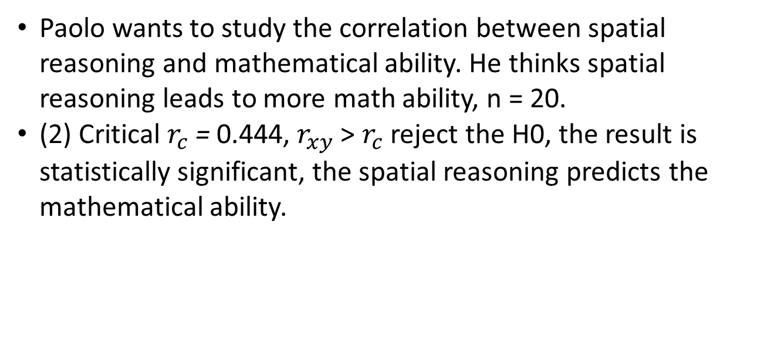
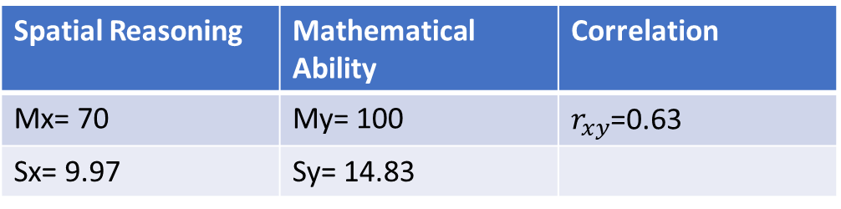
In-Class Practice
Spatial Reasoning | Mathematical Ability | Correlation
Mx= 70 | My= 100 | $r_{xy}$=0.63
Sx= 9.97 | Sy= 14.83
Paolo wants to study the correlation between spatial reasoning and mathematical ability. He thinks spatial reasoning leads to more math ability, n = 20.
(2) Critical $r_{c}$ = 0.444, $r_{xy}$ > $r_{c}$ reject the H0, the result is statistically significant, the spatial reasoning predicts the mathematical ability.

Slide 26

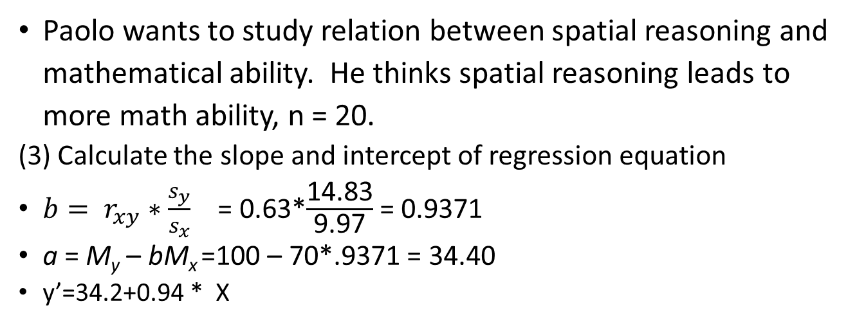
In-Class Practice
Spatial Reasoning | Mathematical Ability | Correlation
Mx= 70 | My= 100 | $r_{xy}$=0.63
Sx= 9.97 | Sy= 14.83
Paolo wants to study relation between spatial reasoning and mathematical ability. He thinks spatial reasoning leads to more math ability, n = 20.
(3) Calculate the slope and intercept of regression equation
$b= r_{xy}∗\frac{s_{y}}{s_{x}}$ = 0.63*$\frac{\text{14.83}}{\text{9.97}}$ = 0.9371
a = M_{y} – bM_{x} =100 – 70*.9371 = 34.40
y’=34.2+0.94 * X

Slide 27
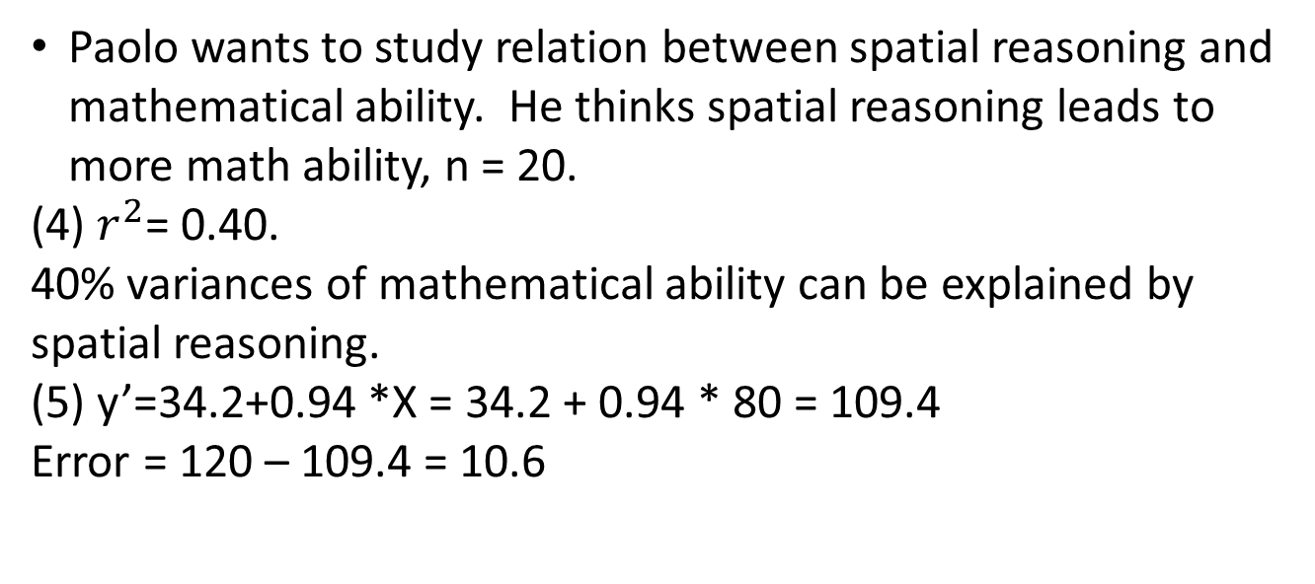
In-Class Practice
Spatial Reasoning | Mathematical Ability | Correlation
Mx= 70 | My= 100 | $r_{xy}$=0.63
Sx= 9.97 | Sy= 14.83
Paolo wants to study relation between spatial reasoning and mathematical ability. He thinks spatial reasoning leads to more math ability, n = 20.
(4) $r^{2}$= 0.40.
40% variances of mathematical ability can be explained by spatial reasoning.
(5) y’=34.2+0.94 *X = 34.2 + 0.94 * 80 = 109.4
Error = 120 – 109.4 = 10.6

Slide 28
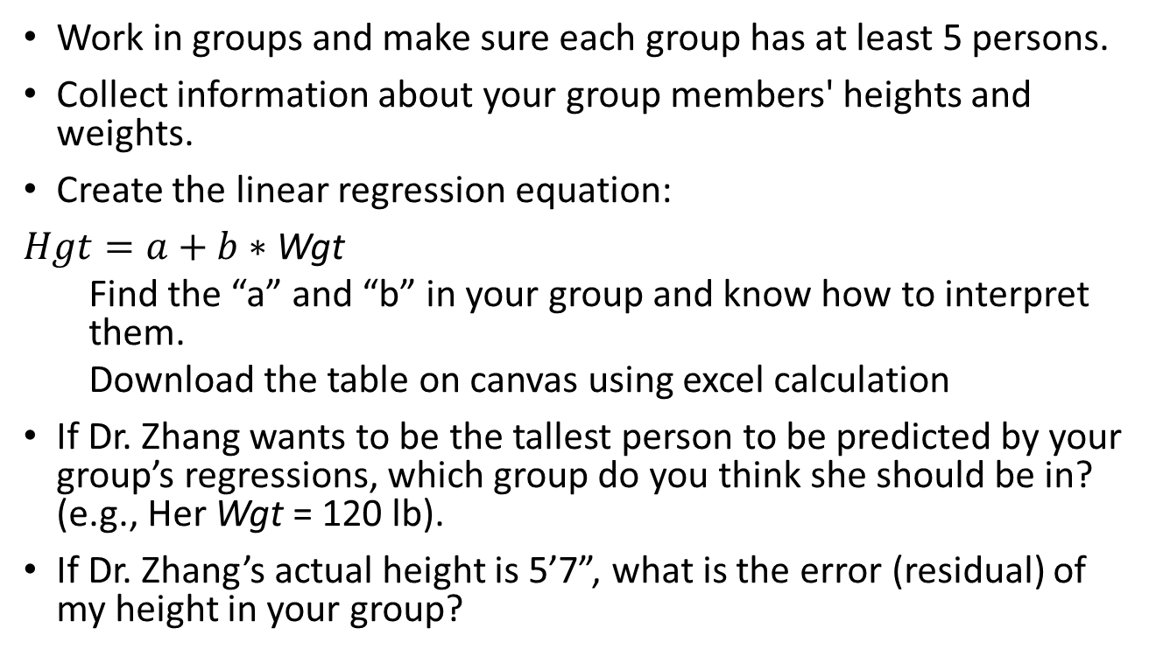
Linear Regression Activity
Work in groups and make sure each group has at least 5 persons.
Collect information about your group members' heights and weights.
Create the linear regression equation:
$Hgt=a+b∗$ Wgt
Find the “a” and “b” in your group and know how to interpret them.
Download the table on canvas using excel calculation
If Dr. Zhang wants to be the tallest person to be predicted by your group’s regressions, which group do you think she should be in? (e.g., Her Wgt = 120 lb).
If Dr. Zhang’s actual height is 5’7”, what is the error (residual) of my height in your group?

Slide 29
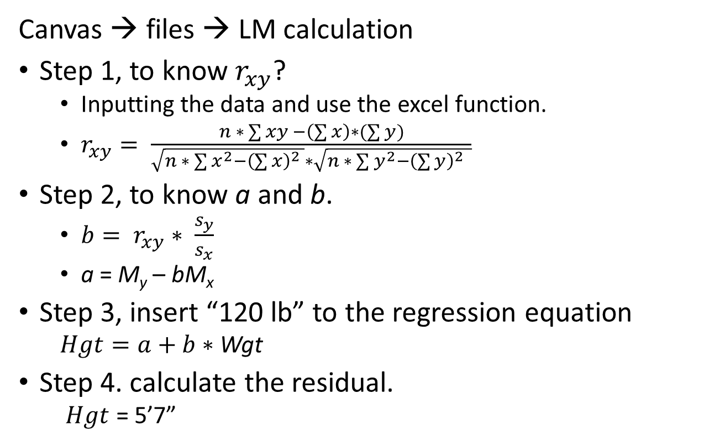
Formulas to Use
Canvas → files → LM calculation
Step 1, to know $r_{xy}$?
Inputting the data and use the excel function.
$r_{xy}= \frac{n ∗ \sum{xy −\left(\sum{x}\right)∗(\sum{y})}}{\sqrt{n ∗ \sum{x^{2}−{\left(\sum{x}\right)}^{2} }}∗\sqrt{n ∗ \sum{y^{2}−{\left(\sum{y}\right)}^{2} }}}$
Step 2, to know a and b.
$b= r_{xy}∗ \frac{s_{y}}{s_{x}}$
a = M_{y} – bM_{x}
Step 3, insert “120 lb” to the regression equation
$Hgt=a+b∗$ Wgt
Step 4. calculate the residual.
$Hgt$ = 5’7”

